Slide 1
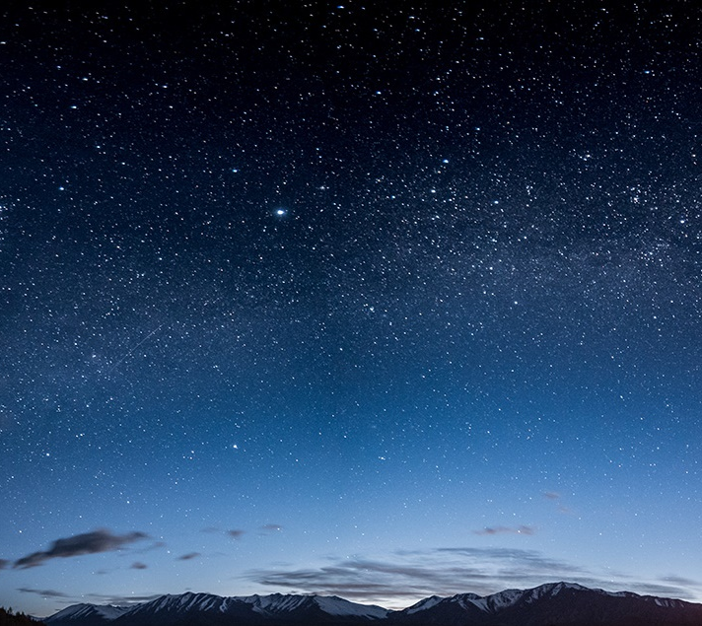
Natural Learning and Play space Forest Hill school
Stakeholder Meeting – Monday, january 27, 2020

Slide 2
welcome
Being part of something very exciting; creating a lasting legacy in our community
Creation of the BEST natural play space and learning commons in Canada.

Slide 3
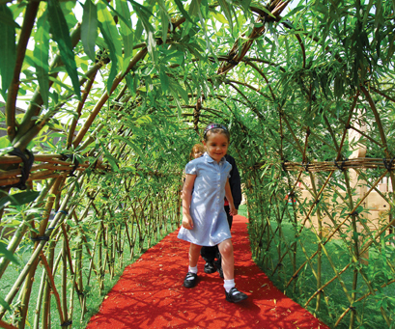
Agenda for the evening
Vision & Purpose
School & Committee Goals
Research & Other Important Information
Group Brainstorming
Inspiration Walk
Planning, Visioning, Designing
Challenges & Questions
Connections & Moving Forward

Slide 4
So what do we want to do?
The creation of a natural learning and play space on Forest Hill School property
Dream
Vision
Plan
Action
Why
How
When

Slide 5
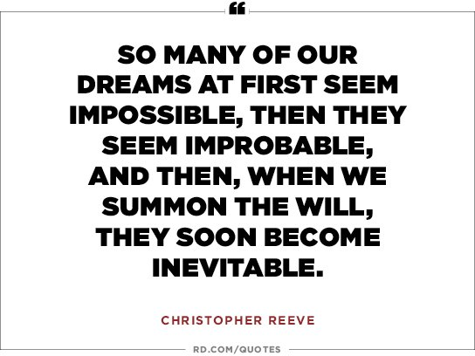
School Improvement Goals
Forest Hill School strives to create a child-centered approach to learning.
Purposeful Play, Outdoor Learning
Whole-child – Readiness for learning
Academic
Social
Emotional
Physical

Slide 6
What does the research / data say?
Community Wellness Profile
NB Health Council (ASD-W)
My Community At A Glance
NB Community Profile Report 2017
K-5 Health behaviors
24.2 % of children get 60 minutes of physical activity daily (the recommended amount of proper growth, development and health)
55.2% of children get more than 2 hours of screen time daily
30% of children demonstrate high levels of pro-social behavior
Availability of parks / public green spaces close to home ~ NB 72% Canada 85%
Children in grades K-5 who are considered overweight ~ 33%
42% of families are physically active with their children (2013-2014)

Slide 7
What does the research / data say? Mental health
Protective Factors
2018-2019 NB Student Wellness Survey
Communities and schools who place an emphasis on protective factors can lead to an improvement in many of the negative results among youth.
A briefing will be released “shortly” looking at this connection in greater detail.
39 000 students in 187 schools in grades 6-12 completed the survey
Symptoms of anxiety & depression – 48% of students (up from 40% in 2015-2016)
That is 18 720 of our youth are struggling with mental wellness!

Slide 8
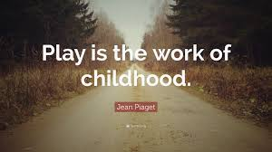
http://www.kidactive.ca/kidactive-resources/2015-position-statement-active-outdoor-play
https://www.outdoorplaycanada.ca/
https://globalnews.ca/news/5987487/outdoor-play-children-canada/
http://childnature.ca/
https://www.wellnessnb.ca/wp-content/uploads/2015/11/NB-Playbook.pdf
https://www.conservationcouncil.ca/en/our-programs/community/no-child-left-inside/
http://www.naturenb.ca/partnership-programs/great-minds-think-outside-en/
Purposeful Play by Kristine Mraz , Alison Porcelli, Cheryl Tyler
Balanced & Barefoot by Angela J. Hanscom

Slide 9
Vision: All children in our community, regardless of culture, language or socio-economic status require access to outdoor natural spaces for learning and playing. Accessibility to such an environment is crucial for proper physical development, mental health and social-emotional intelligence – all crucial foundational skills for academic learning. In order to best provide children with an authentic opportunity to develop the physical, emotional, and social skills needed to reach one’s full potential, students must have the opportunity to take healthy risks, explore independently and with their peers in balance with direct instruction and planned learning opportunities by knowledgeable educators.

Slide 10
How did we get here & where are we going?
Natural playground and learning concept committee
Strong support from our PSSC
Student input
Stakeholder meeting – community input
Creation of an overall concept design
Action (creation of blue-prints, prioritizing & phasing, costs, grant writing & fundraising)
Sustainability & maintenance
This Photo by Unknown Author is licensed under CC BY-SA

Slide 11
What would you like to see in the creation of this concept?
Learning commons
Music space
Water , mud & loose parts
Plants, trees, gardens
Climbing, rolling, spinning, running
Open space
Accessibility for all physical abilities

Slide 12
What are some questions or challenges you have or see?
Safety concerns for children
Cleanliness, equipment, clothing for children
The potential for a new school built in a different area of our community
Maintenance and sustainability
Other

Slide 13
Connections & next steps
Who do we connect with?
Who can help us?
Phasing & prioritizing of the project

